Slide 1
Second-Hand Car Trade Using Blockchain
By:
Arun Pradeep 195002014
Bhavna Magendiran 195002021
Guided by:
Dr. S. Mohanavalli

Slide 2
OUTLINE
Expected Outcomes
System Design
Implementation
Techstack used
Testing
Challenges
Future work

Slide 3
EXPECTED OUTCOMES
PHASE 1 | Planning Phase | Requirements of the project, identifying business problem
PHASE 2 | Design Phase | Blockchain architecture, other technical details
PHASE 3 | Development Phase | development of application (Front-end, Back-end separately)
PHASE 4 | Deployment Phase | Integration of Front-end and Back-end Deployment of application
PHASE 5 | Production Phase | Testing, Deploying application
Notes:
A

Slide 4
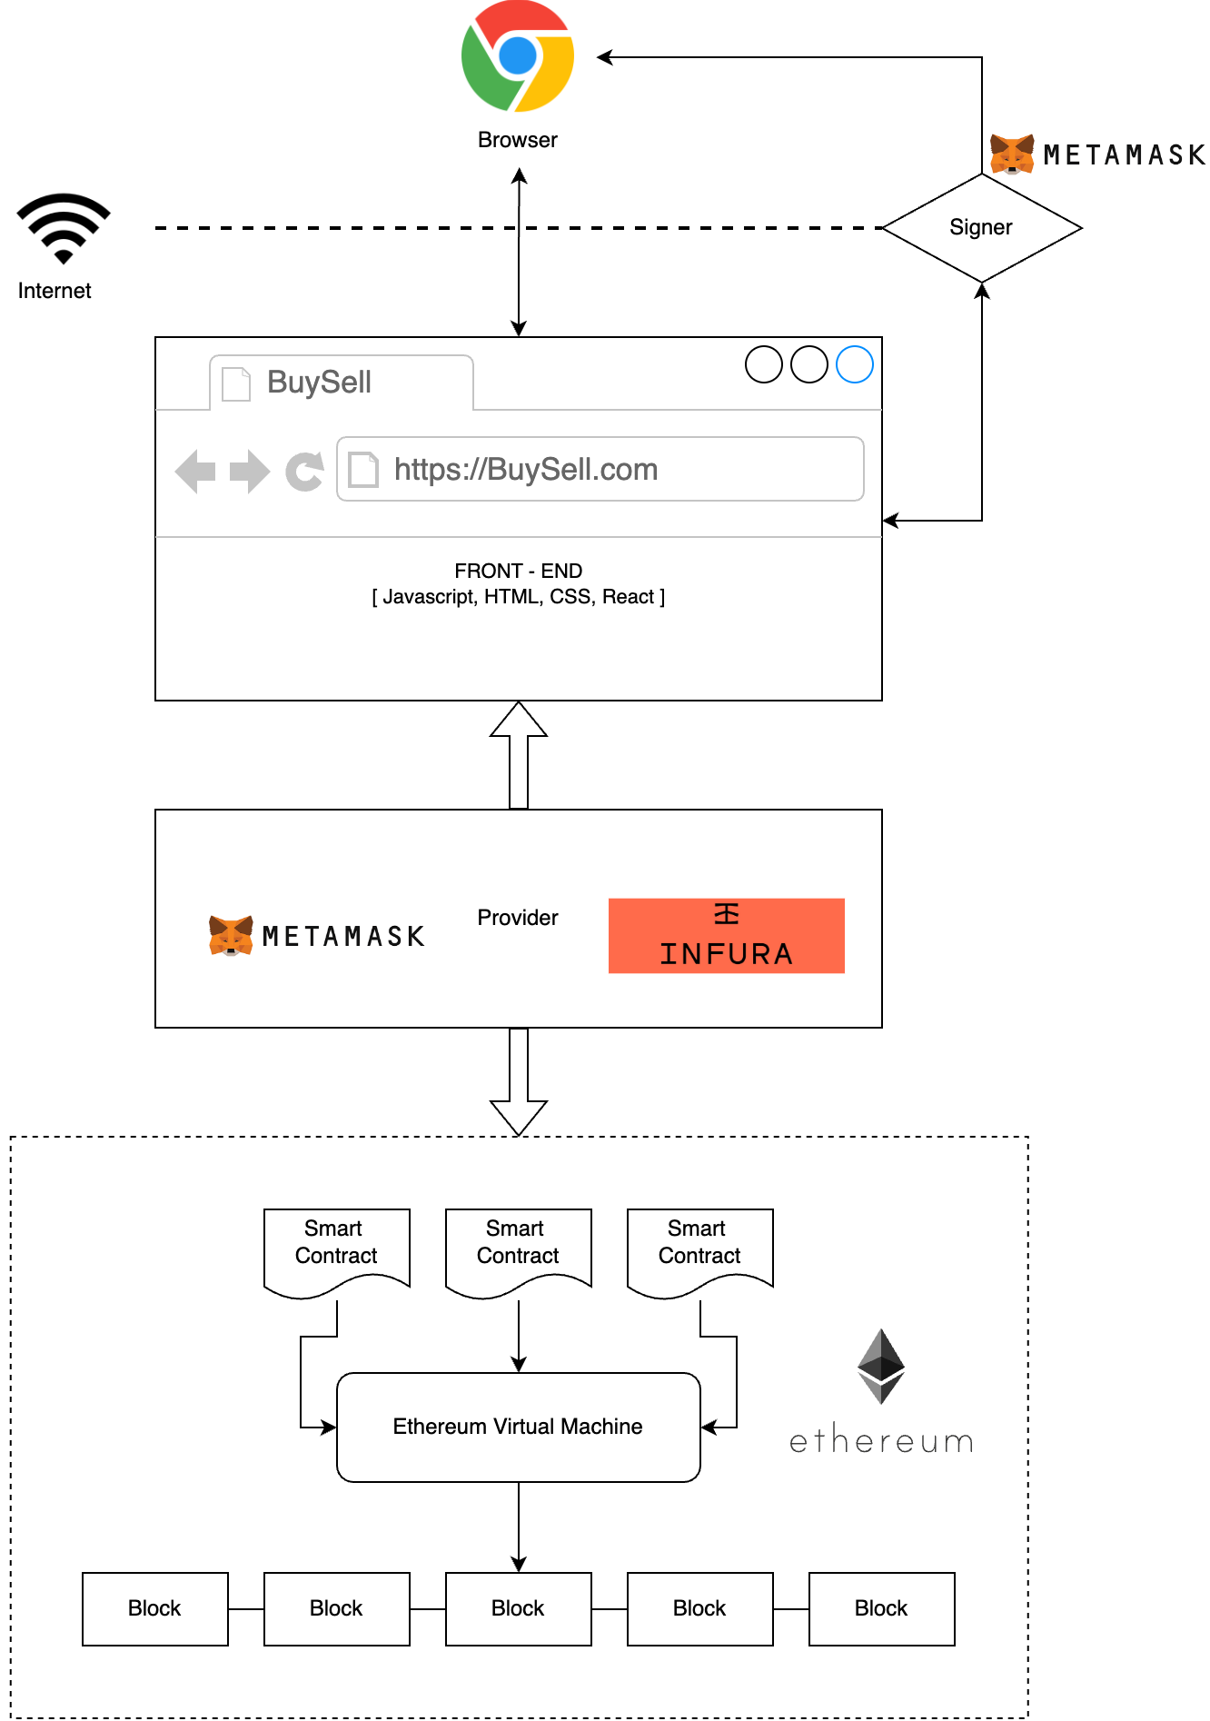
SYSTEM DESIGN - DAPP Architecture

Slide 5
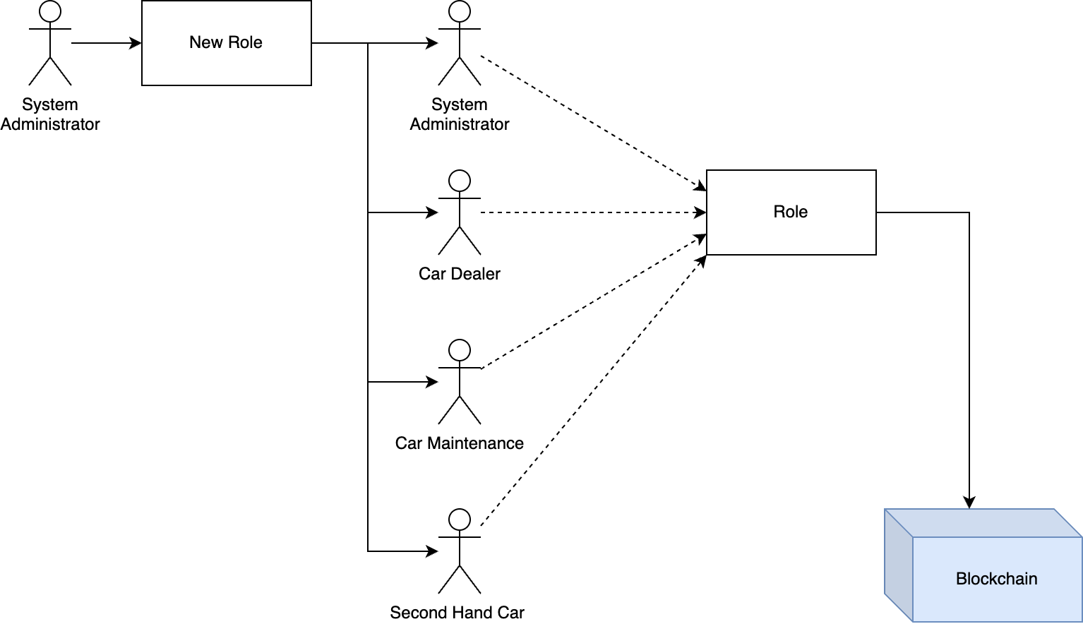
SYSTEM DESIGN - Workflow

Slide 6
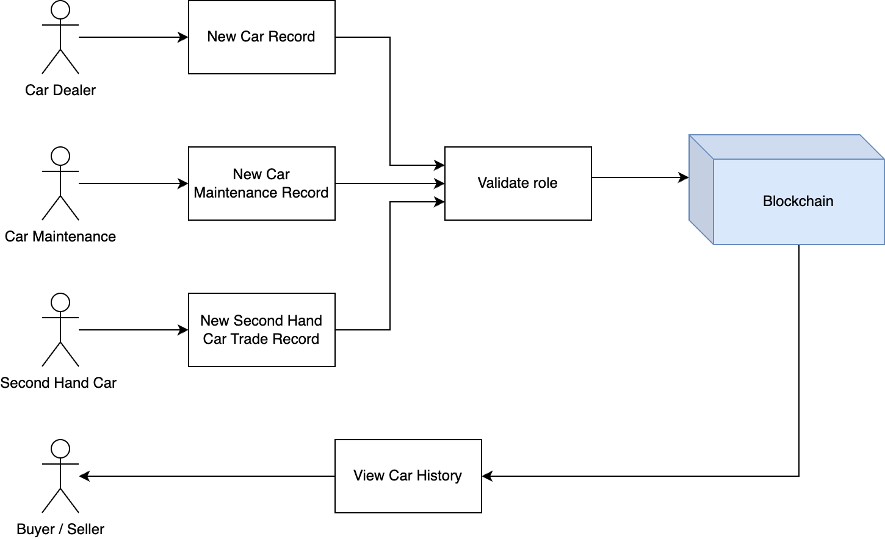
SYSTEM DESIGN - Workflow

Slide 7
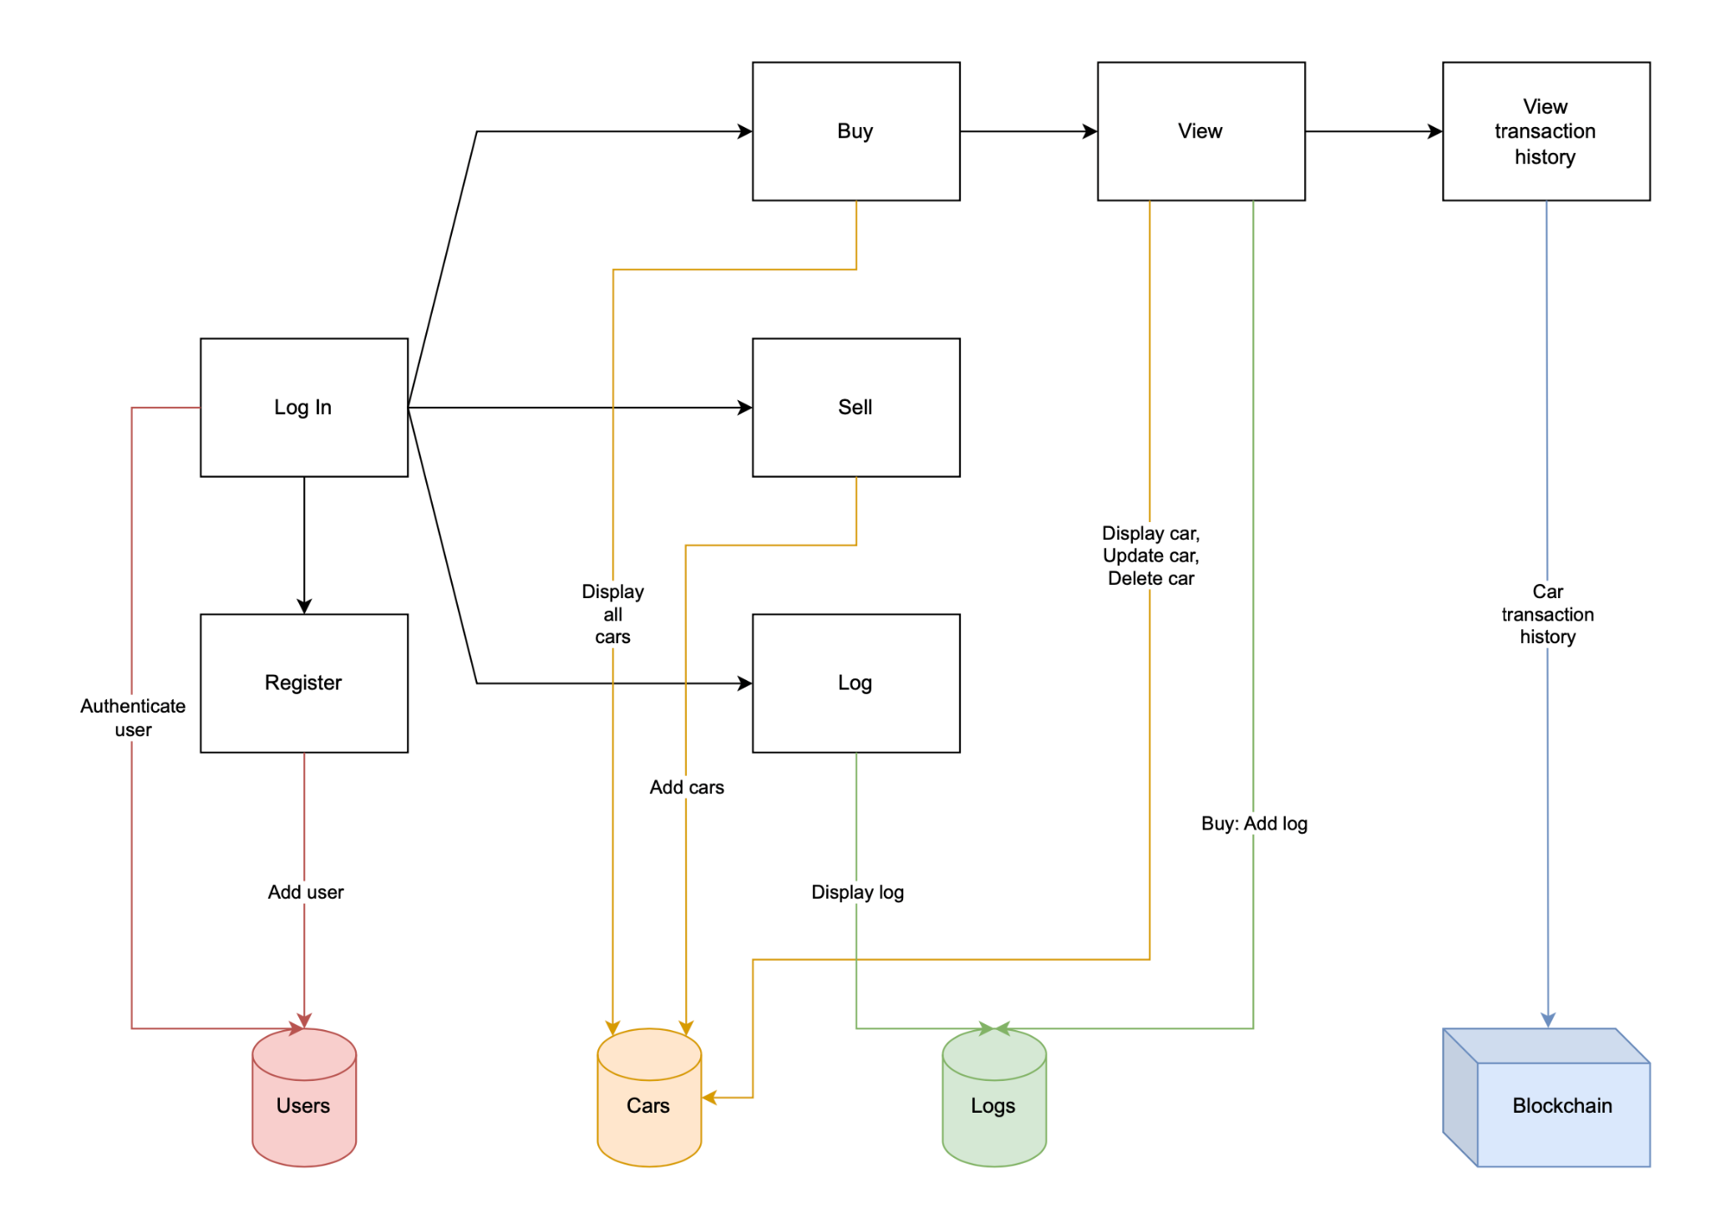
SYSTEM DESIGN - Workflow

Slide 8
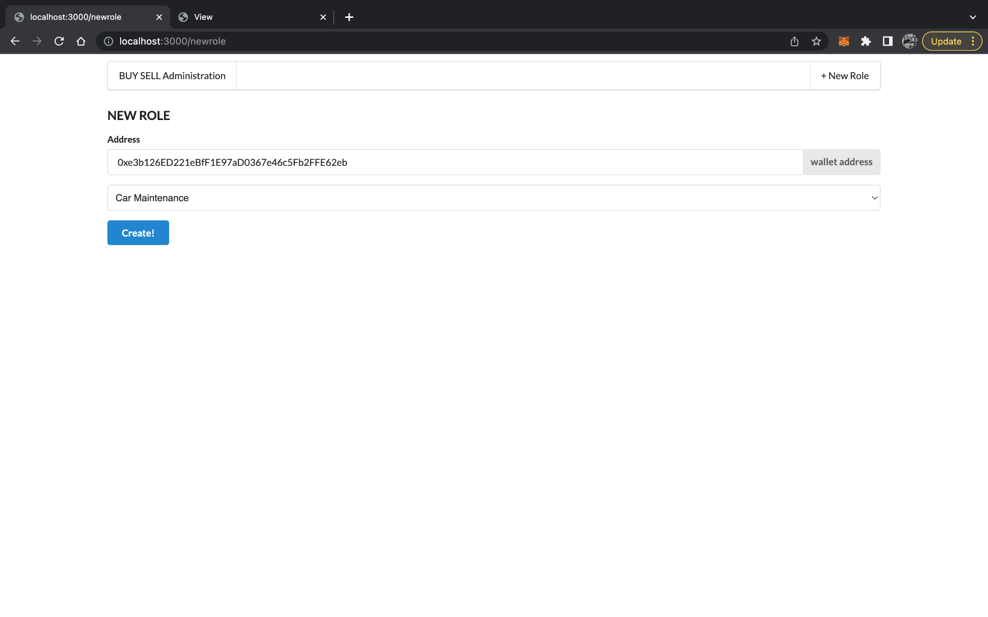
IMPLEMENTATION
Notes:
https://drive.google.com/file/d/1xV9TocRGyj72LvN5jco7XN7z4AwS-B_C/view?usp=share_link

Slide 9
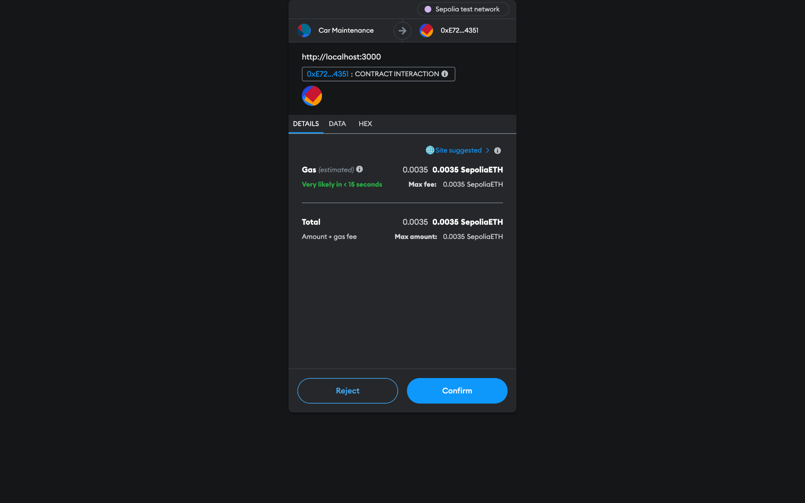
IMPLEMENTATION
Notes:
https://drive.google.com/file/d/1xV9TocRGyj72LvN5jco7XN7z4AwS-B_C/view?usp=share_link

Slide 10
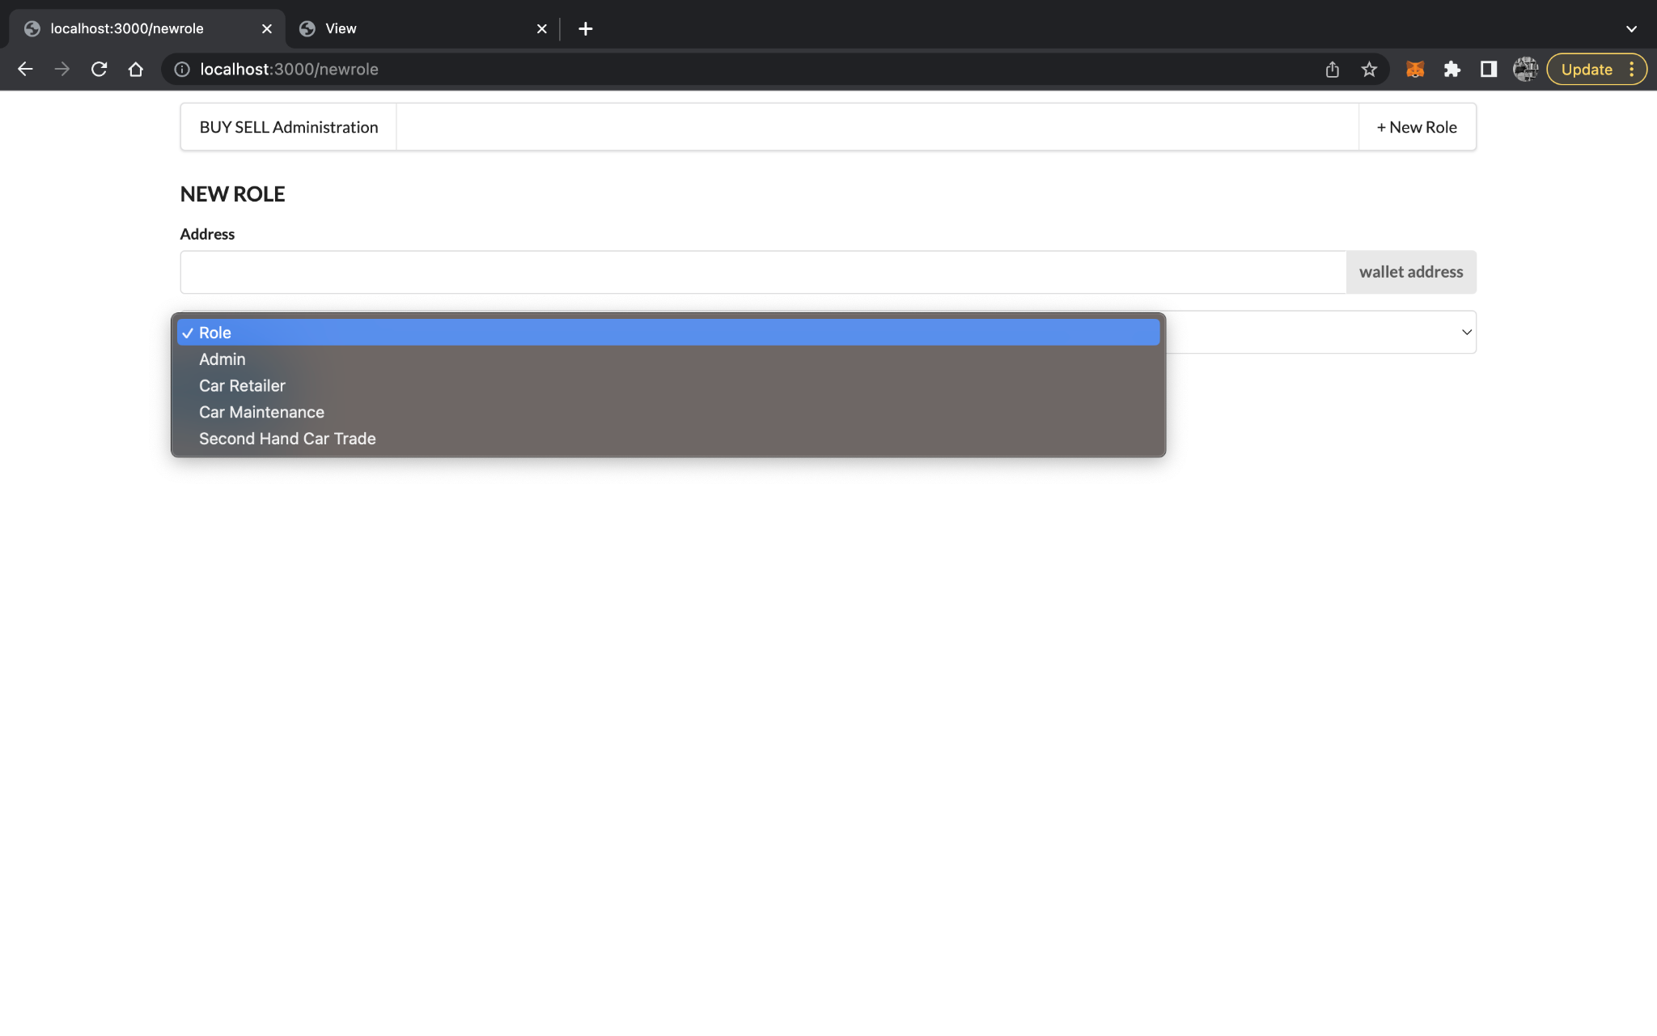
IMPLEMENTATION
Notes:
https://drive.google.com/file/d/1xV9TocRGyj72LvN5jco7XN7z4AwS-B_C/view?usp=share_link

Slide 11
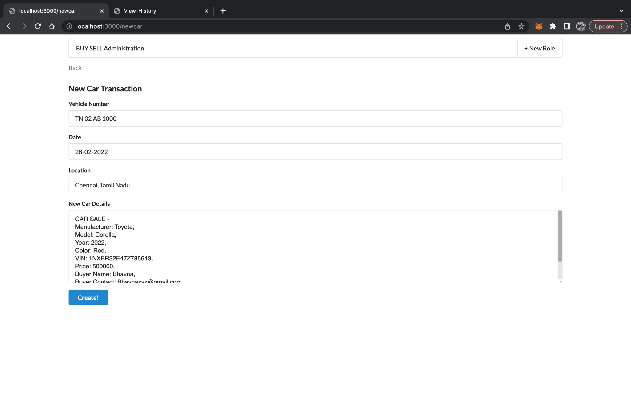
IMPLEMENTATION
Notes:
https://drive.google.com/file/d/1xV9TocRGyj72LvN5jco7XN7z4AwS-B_C/view?usp=share_link

Slide 12
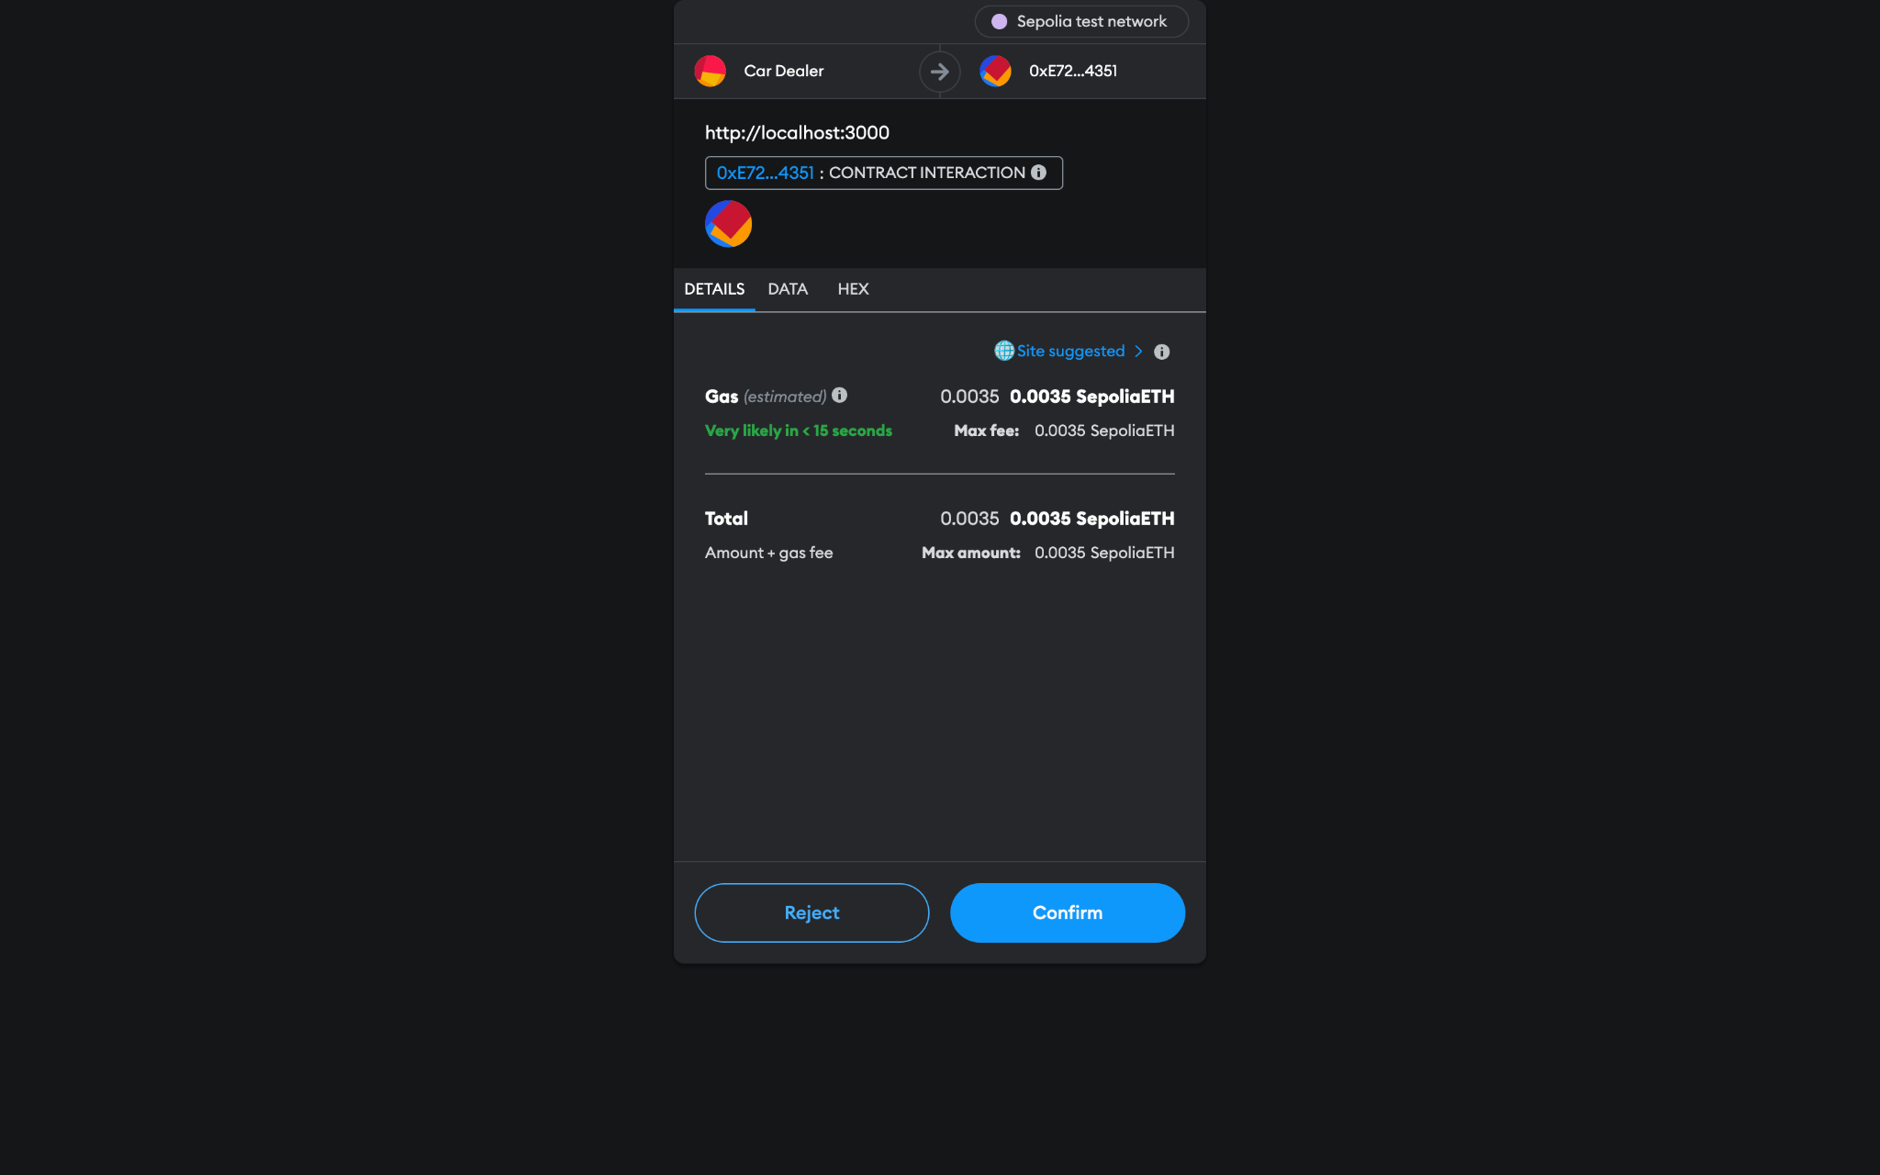
IMPLEMENTATION
Notes:
https://drive.google.com/file/d/1xV9TocRGyj72LvN5jco7XN7z4AwS-B_C/view?usp=share_link

Slide 13
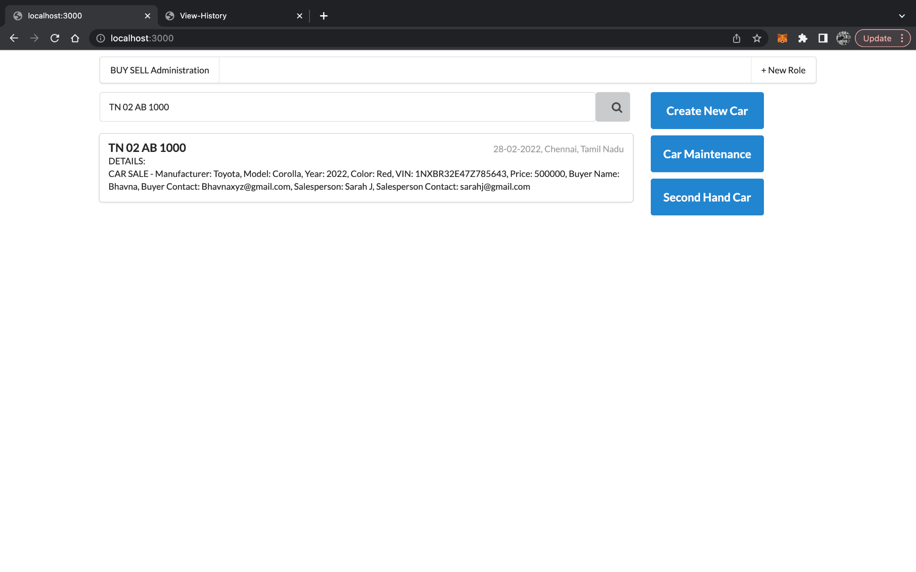
IMPLEMENTATION
Notes:
https://drive.google.com/file/d/1xV9TocRGyj72LvN5jco7XN7z4AwS-B_C/view?usp=share_link

Slide 14
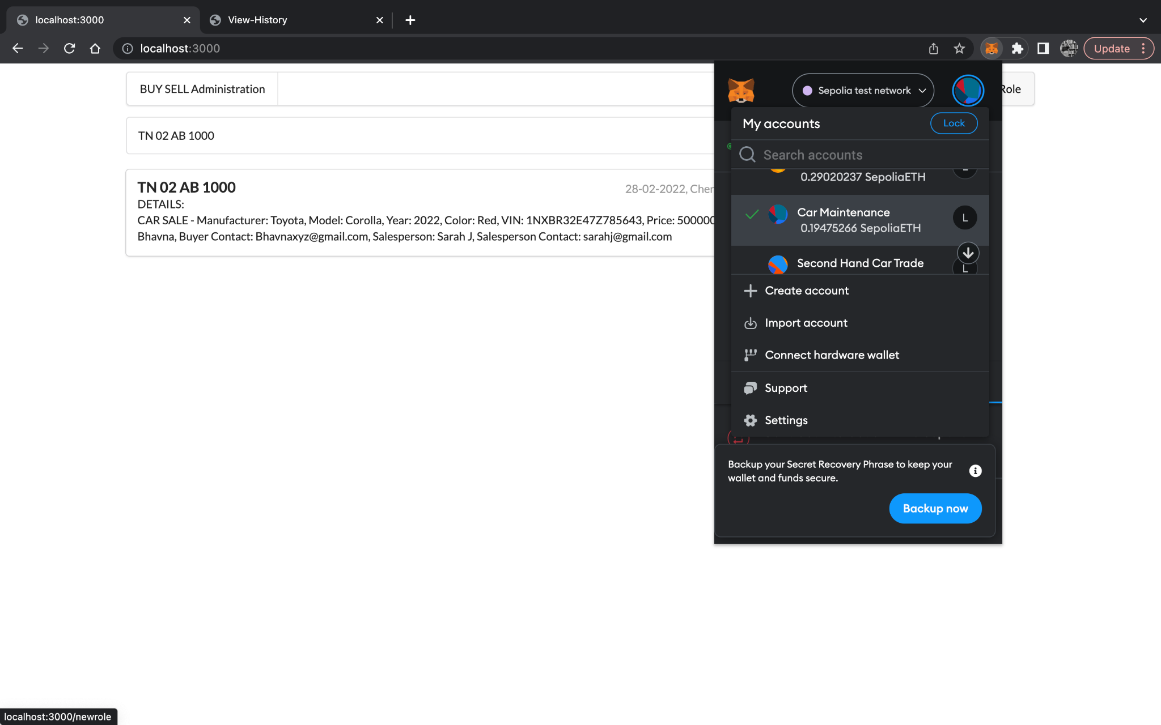
IMPLEMENTATION
Notes:
https://drive.google.com/file/d/1xV9TocRGyj72LvN5jco7XN7z4AwS-B_C/view?usp=share_link

Slide 15
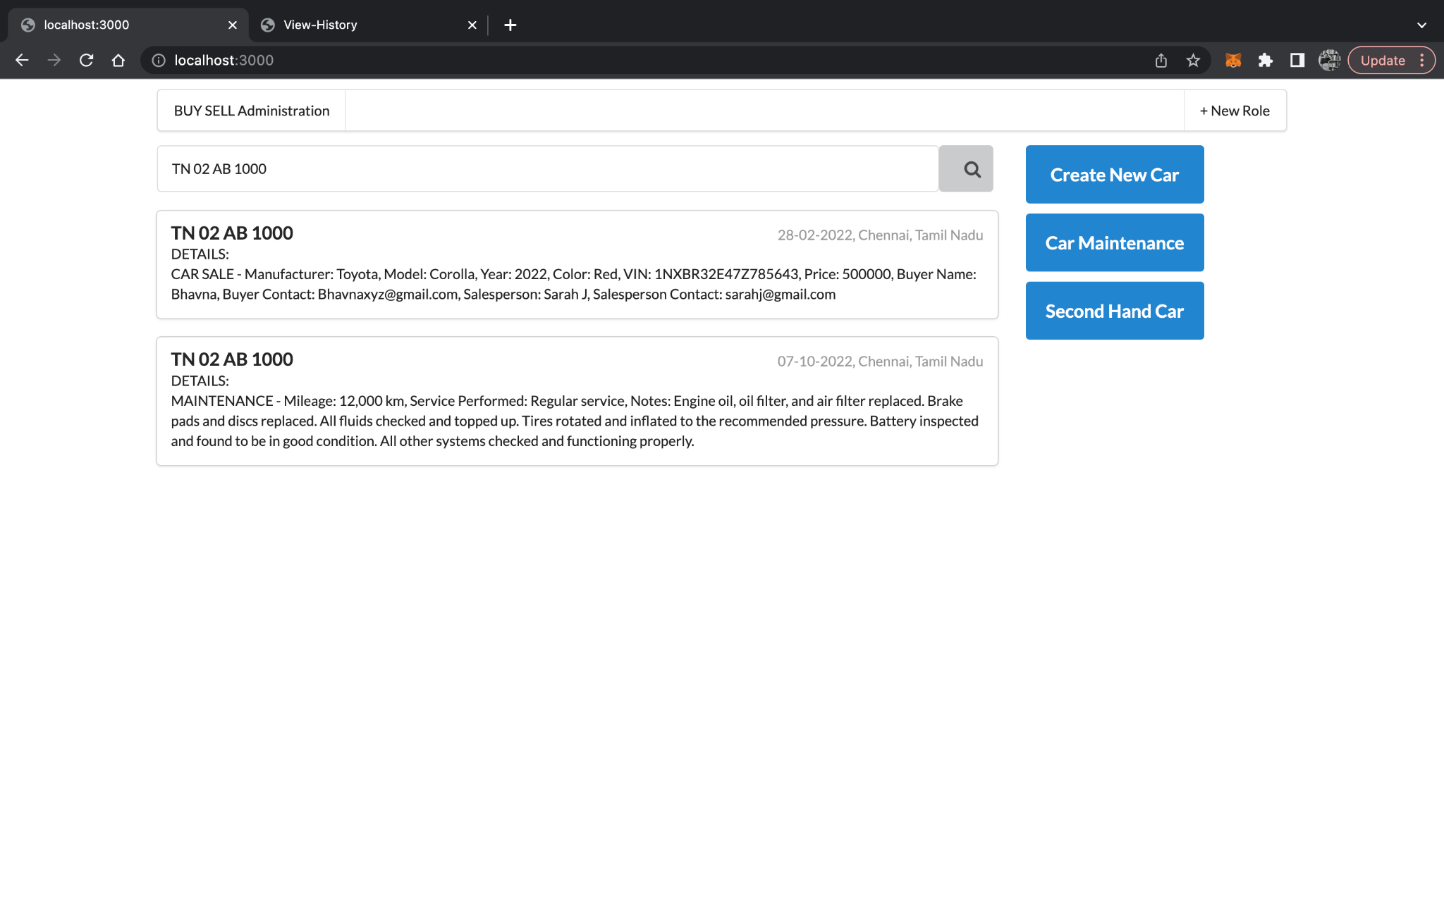
IMPLEMENTATION
Notes:
https://drive.google.com/file/d/1xV9TocRGyj72LvN5jco7XN7z4AwS-B_C/view?usp=share_link

Slide 16
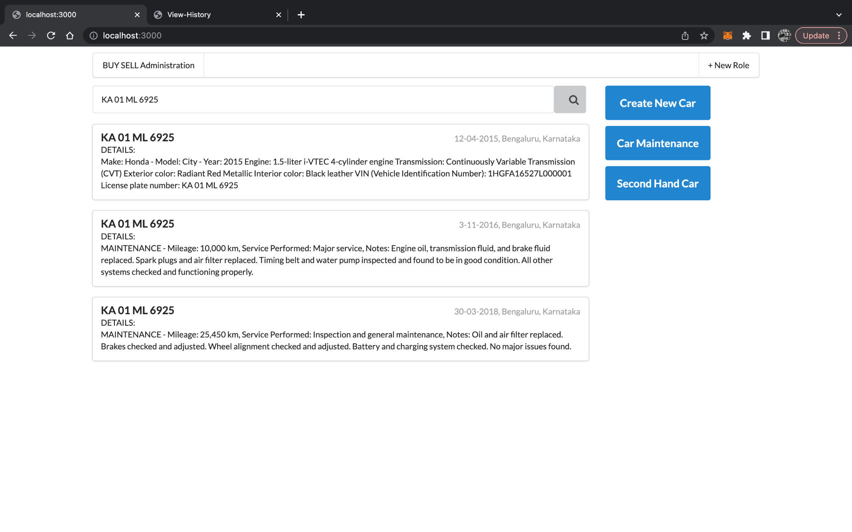
IMPLEMENTATION
Notes:
https://drive.google.com/file/d/1xV9TocRGyj72LvN5jco7XN7z4AwS-B_C/view?usp=share_link

Slide 17
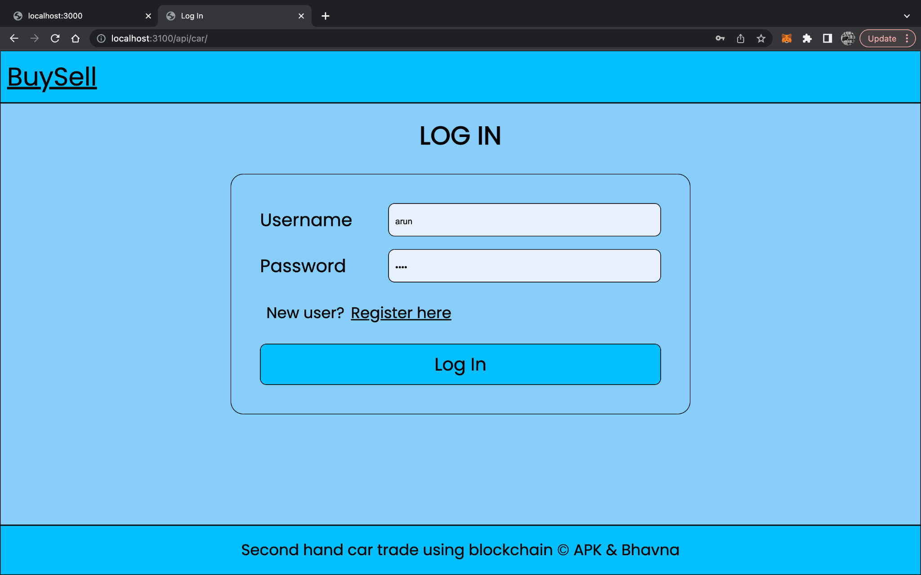
IMPLEMENTATION
Notes:
https://drive.google.com/file/d/1xV9TocRGyj72LvN5jco7XN7z4AwS-B_C/view?usp=share_link

Slide 18
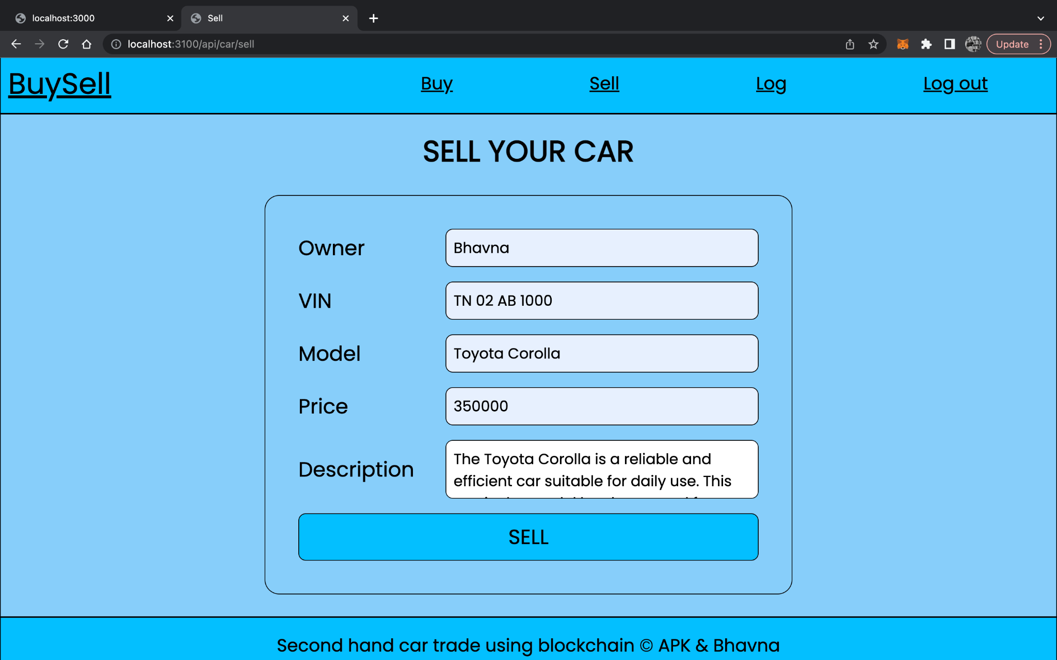
IMPLEMENTATION
Notes:
https://drive.google.com/file/d/1xV9TocRGyj72LvN5jco7XN7z4AwS-B_C/view?usp=share_link

Slide 19
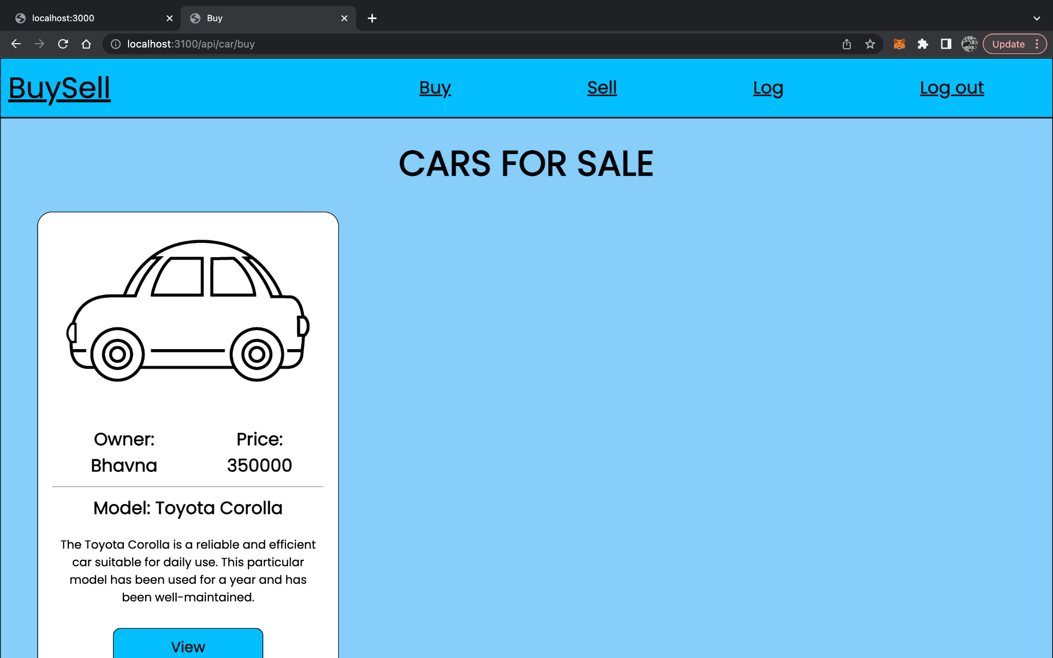
IMPLEMENTATION
Notes:
https://drive.google.com/file/d/1xV9TocRGyj72LvN5jco7XN7z4AwS-B_C/view?usp=share_link

Slide 20
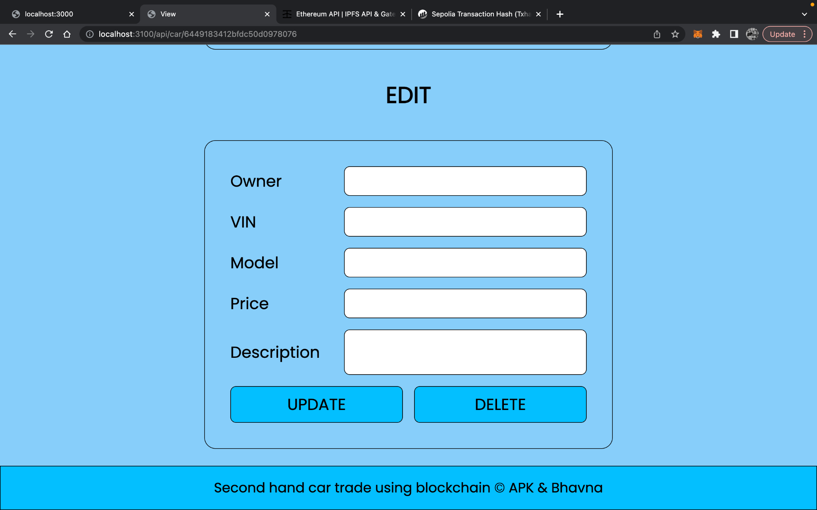
IMPLEMENTATION

Slide 21
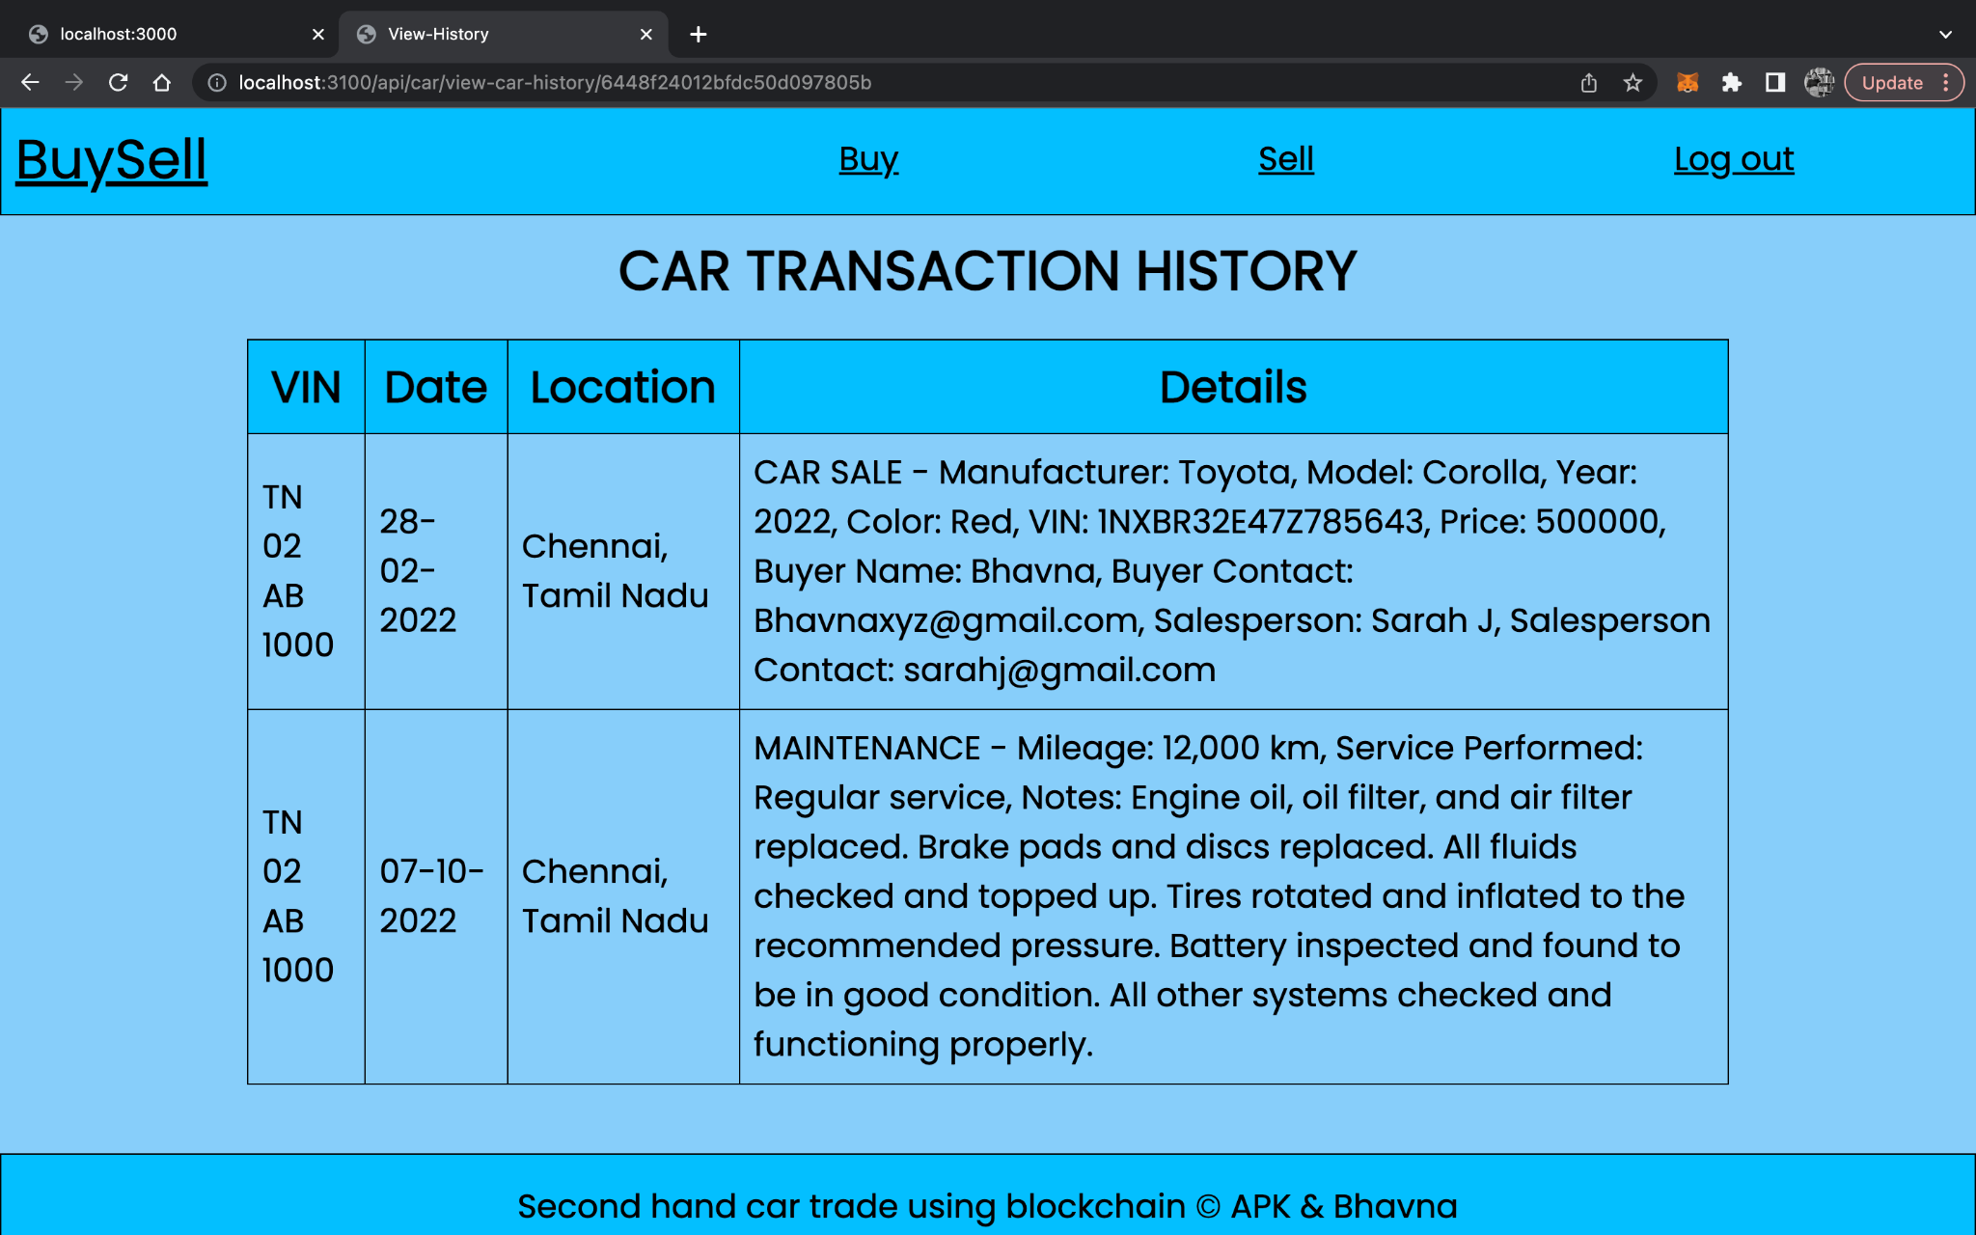
IMPLEMENTATION
Notes:
https://drive.google.com/file/d/1xV9TocRGyj72LvN5jco7XN7z4AwS-B_C/view?usp=share_link

Slide 22
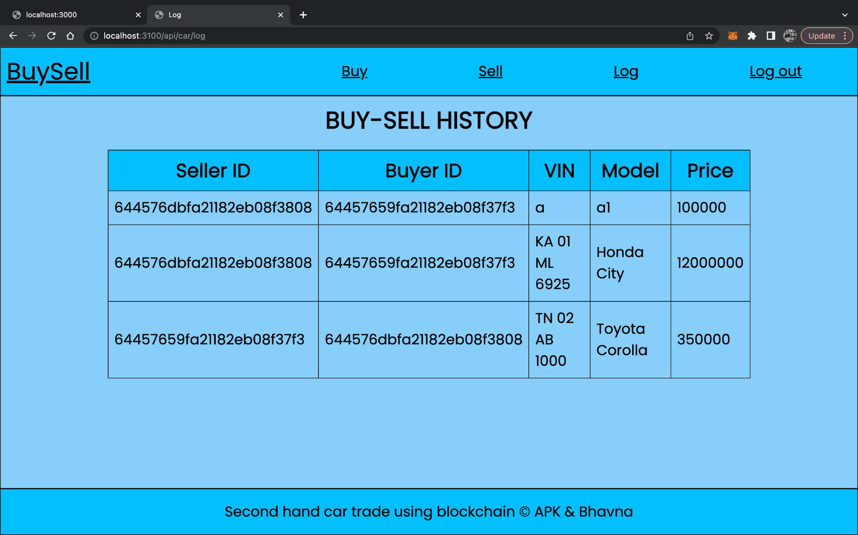
IMPLEMENTATION
Notes:
https://drive.google.com/file/d/1xV9TocRGyj72LvN5jco7XN7z4AwS-B_C/view?usp=share_link

Slide 23
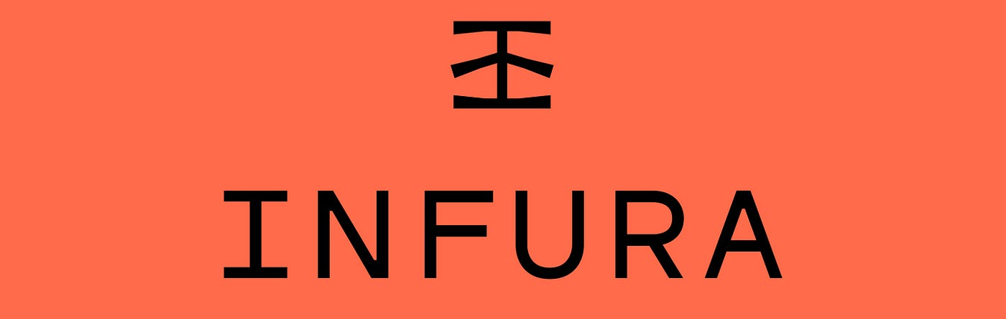
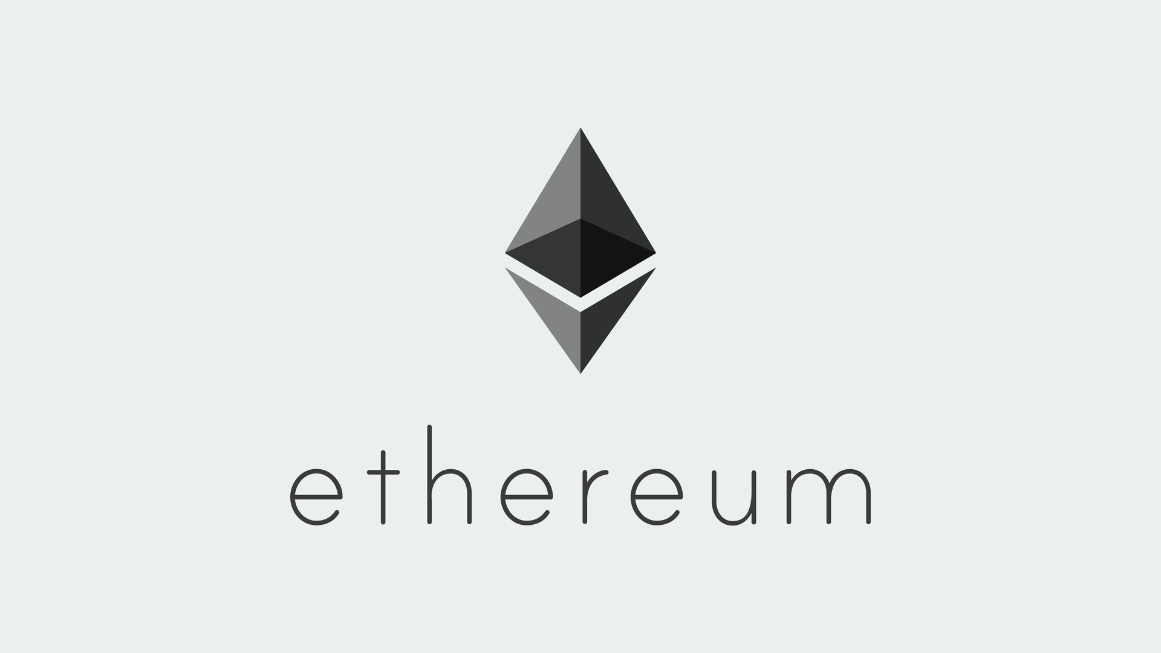
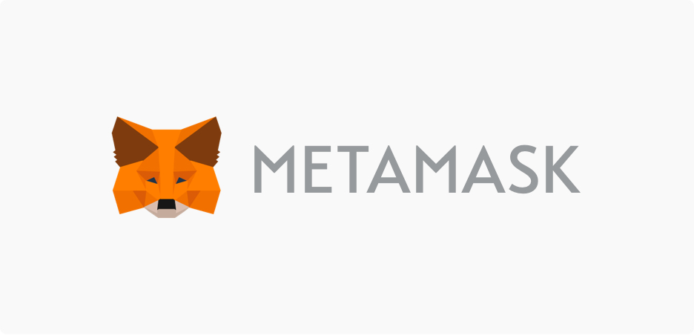
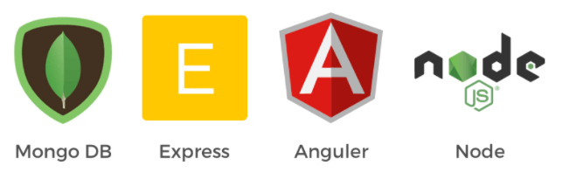


TECHSTACK
Notes:
https://drive.google.com/file/d/1xV9TocRGyj72LvN5jco7XN7z4AwS-B_C/view?usp=share_link

Slide 24
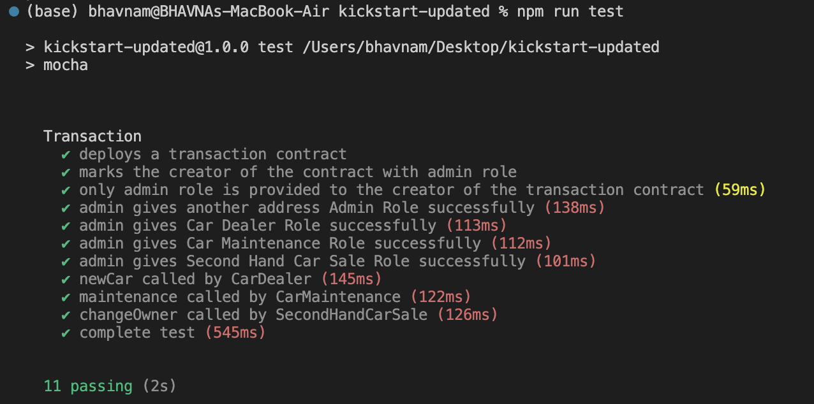
Testing
Notes:
https://drive.google.com/file/d/1xV9TocRGyj72LvN5jco7XN7z4AwS-B_C/view?usp=share_link

Slide 25
Challenges
Limited adoption: Due to its relatively new and growing technology, which makes it foreign to certain users who may be hesitant to use it, the adoption of a blockchain-based application for the trading of used cars may be limited.
Lack of a regulatory framework: might lead to legal ambiguities and make it difficult to get the required permissions. There are now no clear rules or norms governing the use of blockchain technology in this industry.
Integration with current systems: It may be difficult and time-consuming to integrate the application with several existing systems, including databases for car registration and insurance information.
Scalability and performance: Despite the resource-intensive and slow pace nature of blockchain technology, the application must be designed to accommodate a high amount of transactions and users while also ensuring that it stays quick and responsive.
User education and adoption: To ensure the application's acceptance, it will be necessary to invest a lot of time and energy in educating users about the advantages of adopting blockchain technology.
Notes:
https://drive.google.com/file/d/1xV9TocRGyj72LvN5jco7XN7z4AwS-B_C/view?usp=share_link

Slide 26
Future Work
Integration with other blockchains: Although Ethereum is now the most well-liked blockchain for creating decentralized apps, other blockchains like Hyperledger Fabric are gaining popularity. Investigating the potential for integration with social networks may provide consumers more choices and enhance the application's general usability.
Integration with IoT devices: As more devices connect to the internet, the functionality of the application may be improved through integration with IoT devices. For instance, interfacing with the car's sensors might deliver real-time information about the performance and condition of the vehicle, which could then be recorded on the blockchain and accessed by prospective purchasers.
Use of smart contracts for automated transactions: By automatically transferring ownership when specific criteria are satisfied, smart contracts may be used to automate the purchasing and selling process. For instance, when the buyer has paid the agreed-upon amount, a smart contract may be made to automatically transfer ownership of the automobile. This may simplify the procedure and lessen the need for middlemen.
Decentralized finance (DeFi) integration: With the growth of DeFi, there are now more chances than ever to incorporate blockchain technology into financial services. While preserving the confidentiality and transparency of the blockchain, integrating the application with DeFi protocols might give users access to financial services like lending, borrowing, and trading.
Notes:
https://drive.google.com/file/d/1xV9TocRGyj72LvN5jco7XN7z4AwS-B_C/view?usp=share_link

Slide 27
THANK YOU!

